Slide 1
PROJECT TITLE:A One Stop Solution Focusing On Tourism
PIP104 University Project-II
Final Review
Batch Number:
Under the Supervision of,
Ms. Amirtha Preeya Venkatachalam
Assistant Professor
School of Computer Science & Engineering
Presidency University
Roll Number | Student Name
20211COM0097 | P.AYEESHA ANJUM
20211COM0065 | ADVI S.R
20211COM0048 | ANUSHA R.M

Slide 2
Introduction
The goal is to create a comprehensive tourism platform that addresses inefficiencies in both planning and execution. Existing tourism solutions frequently require users to depend on multiple platforms to handle various aspects such as hotel reservations, transportation, and activity organization, resulting in fragmented and labor-intensive experiences. These inefficiencies obstruct smooth travel, complicate the planning process, and often lead to missed opportunities for customization. For example, a traveler may need to utilize one platform to book flights, another for local transport, and yet a different one for organizing activities, resulting in a disjointed experience.
By tackling these challenges, the proposed platform intends to consolidate services, provide real-time suggestions, and ensure a unified user experience. The system combines various services into one framework, allowing users easy access to bookings, recommendations, and tailored plans. This holistic strategy makes tourism experiences more convenient and effective, while addressing issues such as scattered information, lack of coordination, and limited accessibility. The goal is to create a comprehensive tourism platform that removes inefficiencies in both planning and execution.

Slide 3
Literature Review
Name of Paper | Authors | Methodology Used | Results | Drawbacks
All-for-one tourism from the perspective of informatization | L. Yijun, G. Huijun | Analytical review and case studies | Highlighted benefits of integrated tourism approaches | May overlook regional differences
Smart Tourism Destinations | D. Buhalis, A. Amaranggana | Theoretical framework and case studies | Framework for integrating smart technologies in tourism | Generalized findings
Web mapping service for mobile tourist | N. Teslya | Development of a web-based mapping service | Facilitated easier access to tourist information | Dependence on internet connectivity
Mobile application for guiding tourist activities: tourist assistant - TAIS | A. Smirnov, A. Kashevnik, N. Shilov, N. Teslya, A. Shabaev | Design and implementation of a mobile app | Enhanced tourist navigation and activity planning | May lack comprehensive data
The Development of Travel Mobile Application for Local Malaysian Tourism Destinations | M. F. A. B. Nordin, R. A. Aruchunan, N. H. B. Mahamarowi | Development and user testing of a mobile app | Improved user engagement and local tourism visibility | Limited to local destinations
Smart tourism model of self-help tourists' perception framework construction and empirical research | Z. Haiou | Empirical research and framework construction | Insight into self-help tourist behaviors and preferences | Limited sample size

Slide 4
Research Gaps Identified
Summary of Current Approaches :
Current travel platforms such as Expedia, Booking.com, Airbnb, Uber, and MakeMyTrip have transformed how individuals organize and enjoy their trips. These platforms provide ease of access, convenience, and a broad selection of choices for users. Nevertheless, they mostly operate as separate entities, frequently lacking the ability to deliver a cohesive and comprehensive experience.
Strengths of Existing Platforms:
Expedia and Booking.com: Provide extensive options for lodging and airfare.
Airbnb: Emphasizes distinctive and local living experiences.
Uber and Lyft: Streamline travel arrangements for visitors.
MakeMyTrip: Merges ticket purchases with some activity reservations.
Limitations:
Disparate Systems: Users are required to use various platforms to finalize their travel plans.
Insufficient Interconnectivity: The lack of data sharing among platforms hinders the synchronization of reservations.
Limited Customization: Platforms frequently provide universal recommendations, neglecting to consider individual preferences or situational elements like weather or traffic conditions.

Slide 5
Research Gaps Identified
Technical Gaps
Existing tourism platforms depend on obsolete or restricted technical infrastructures, which obstruct their capacity to grow, adjust, and deliver real-time solutions.
Scalability Issues:
Numerous platforms face difficulties managing traffic during busy seasons. For example, during the holidays, increased demand can lead to server overloads, causing system outages.
Restricted modularity hinders the smooth incorporation of additional features.
Data Integration Challenges:
Tourism services frequently do not have a centralized database that integrates real time information from flights, accommodations, transportation, and local activities.
Separate sources result in lag times and discrepancies in updates.
Security Issues: Weak encryption protocols expose user information to potential breaches. Lack of user oversight regarding privacy settings diminishes trust.

Slide 6
Proposed Method
System Design
The architecture comprises:
Data Aggregation Layer: This layer gathers data from multiple sources, such as hotels, airlines, and event planners. It guarantees that various data flows are collected effectively and formatted consistently to facilitate smooth integration. For example, APIs from hotel reservation services and bus booking systems supply structured data to this layer, which normalizes the information for subsequent processing. Additionally, real-time updates, including flight delays or event cancellations, are incorporated here to maintain the system's responsiveness and accuracy.
Processing Layer: This layer, evaluates user preferences, past data, and live updates to create customized recommendations and predictive analyses. For instance, machine learning algorithms can detect patterns such as favored destinations in certain seasons or forecast possible delays based on weather conditions. The way this layer interacts with the aggregation layer guarantees that insights are prompt and customized to meet individual user requirements, thereby improving the entire experience.
User Interface Layer: This layer acts as the interaction point for users. It consolidates outputs from the processing layer to provide real-time updates, customizable itineraries, and an accessible experience via mobile applications and websites. Elements like an easy-to-navigate dashboard, tailored notifications, and engaging maps enable users to handle their bookings with ease. By facilitating seamless data flow between layers, this architecture delivers a unified and reactive platform for travelers.

Slide 7
Objectives
To Provide a Comprehensive Platform that Brings Together Various Tourism-Related Services
The tourism sector is intricate, encompassing a range of participants like buses, hotels, transport services, and local attractions. Current systems frequently compel users to traverse multiple platforms to meet their travel requirements, leading to inefficiencies and a fragmented experience. This initiative seeks to develop an all-inclusive platform that consolidates all vital services within a single interface, facilitating smooth and efficient travel planning.
Key Features of Integration:
Integration Across Services Tourism services are often fragmented, compelling travelers to utilize various platforms for booking buses, securing hotel accommodations, arranging local transportation, purchasing event tickets, and finding restaurant suggestions. This creates a fragmented experience where users must repeatedly input their preferences and manually synchronize different facets of their travel. The suggested platform addresses these issues by consolidating all vital services into a single, unified system. For example, users can effortlessly search for buses, reserve hotels, and organize transportation within the same platform. Moreover, the system supports bundled offerings, including combinations of flights, lodging, and guided tours, providing both ease and financial benefits. This degree of integration guarantees that travelers can concentrate on enjoying their experiences instead of navigating logistical hurdles.
Real-Time Synchronization:One of the platform's most groundbreaking features is its capability to synchronize services instantly, making sure that any changes in one booking are instantly updated in related reservations. For example, if a traveler's bus is delayed, the platform can alert their hotel and modify the check-in time accordingly. Likewise, transportation services like airport shuttles or car rentals are informed about new arrival times, enabling them to adjust their schedules. This interlinked system reduces disruptions and improves the overall travel experience. Additionally, real-time synchronization also applies to local events and activities. For instance, if an event is canceled, users are promptly notified and offered alternative choices. By ensuring continuous communication among all parties involved, the platform guarantees a smooth and effortless journey.

Slide 8
System Design & Implementation
System Architecture
The system employs a layered architecture, ensuring clear separation of concerns, scalability, modularity, and maintainability. Each layer has distinct responsibilities and communicates efficiently with others through well-defined APIs. This approach not only supports seamless integration but also simplifies debugging, testing, and future enhancements.
User Interface Layer
The user interface layer acts as the main interface for users to engage with the platform. It is crafted to deliver an easy-to-use, aesthetically pleasing, and adaptable user interface (UI). Important technologies employed include:
.NET Framework: Supports server-side rendering and controls session-based interactions to provide a dynamic and tailored user experience. It also connects with backend APIs to manage data flow securely and efficiently.
JavaScript: Introduces interactivity, offering features like real-time form validation, interactive maps, and data visualization charts. JavaScript libraries such as jQuery or frameworks like React.js can be utilized for enhanced capabilities.
HTML and CSS: Guarantee a tidy and responsive design suitable for different devices. CSS preprocessors like SASS/LESS improve design maintainability, while tools such as Tailwind CSS allow for utility-first styling approaches.
Cross-Browser Support: The frontend undergoes thorough testing to ensure compatibility with various browsers, including Chrome, Edge, Firefox, and Safari.

Slide 9
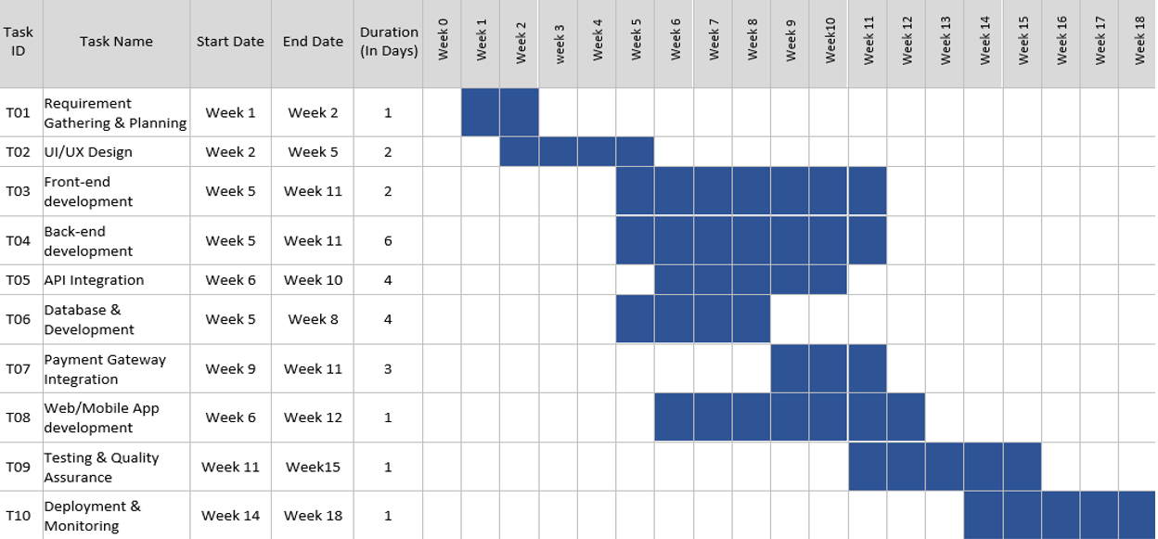
Timeline of Project

Slide 10
Expected Outcomes
Improved User Comfort and Contentment
A significant result of the application is the substantial enhancement in user comfort and contentment. By consolidating multiple services like hotel reservations, cab bookings, event tickets, and customized travel plans, users receive a comprehensive solution that makes travel organization easier. Important results in this aspect include:
Travelers can now avoid the hassle of switching between different platforms for their bookings. The unified system allows them to organize their entire journey from a single location, conserving valuable time and energy.
By utilizing algorithms that examine user preferences and past behaviors, the app provides customized suggestions, including accommodations that fit their budget, local attractions, and activities that match their interests.
Seamless Navigation: A user-friendly interface ensures smooth navigation for all demographics, from tech-savvy millennials to senior citizens, fostering inclusivity.
Real-Time Updates: Notifications about delays, cancellations, or changes to itineraries ensure users are always informed, reducing stress during travel.
Safe Transactions: The incorporation of dependable payment gateways offers users various payment choices while safeguarding their information, fostering trust and assurance in the platform

Slide 11
Conclusion
In summary, the All-in-One Software project successfully integrates multiple services into a unified platform, providing users with a seamless experience for hotel bookings, taxi reservations, and various activities across different cities, all within one application. The frontend was developed using HTML, CSS, and JavaScript, ensuring an attractive and responsive user interface, while the backend employs ASP.NET Core Web APIs to provide a robust and scalable solution. Moreover, SQL Server was used as the database to handle the substantial amount of data generated by bookings, user interactions, and other transactional operations.
The comprehensive design of the project allows users to avoid the need to switch between multiple applications for various services, simplifying their booking process and improving overall efficiency. By leveraging ASP.NET Core Web APIs, the backend is able to adeptly manage complex interactions between the frontend and the database, while also ensuring high performance, security, and scalability. Furthermore, the SQL Server database has been optimized to effectively process large datasets, ensuring fast and reliable data retrieval even during high traffic periods.
The results from the tests conducted on response times, scalability, security, and usability validate the effectiveness of the architecture. The system demonstrated reliable performance even under significant load, effectively managing resources and keeping low latency during user engagement.

Slide 12
References
M. F. A. B. Nordin, R. A. Aruchunan and N. H. B. Mahamarowi, "The Development of Travel Mobile Application for Local Malaysian Tourism Destinations", 2023 IEEE 14th Control and System Graduate Research Colloquium (ICSGRC), pp. 105-110, 2023.
A. Smirnov, A. Kashevnik, N. Shilov, N. Teslya and A. Shabaev, "Mobile application for guiding tourist activities: tourist assistant - TAIS," Proceedings of 16th Conference of Open Innovations Association FRUCT, Oulu, Finland, 2014, pp. 95-100, doi: 10.1109/FRUCT.2014.7000931.
N. Teslya, "Web mapping service for mobile tourist guide," Proceedings of 15th Conference of Open Innovations Association FRUCT, St. Petersburg, Russia, 2014, pp. 135-143, doi: 10.1109/FRUCT.2014.6872438.
D Buhalis and A Amaranggana, "Smart Tourism Destinations[M]" in Information and Communication Technologic in Tourism 2014, Springer International Publishing, pp. 553-564, 2013.
Z Haiou, (01) Southeast Academy Smart tourism model of self-help tourists' perception framework construction and empirical research, pp. 207-213, 2017.
L Yijun and G Huijun, Journal of tourism All-for-one tourism from the perspective of informatization, vol. 31, no. 09, pp. 24-26, 2016.

Slide 13
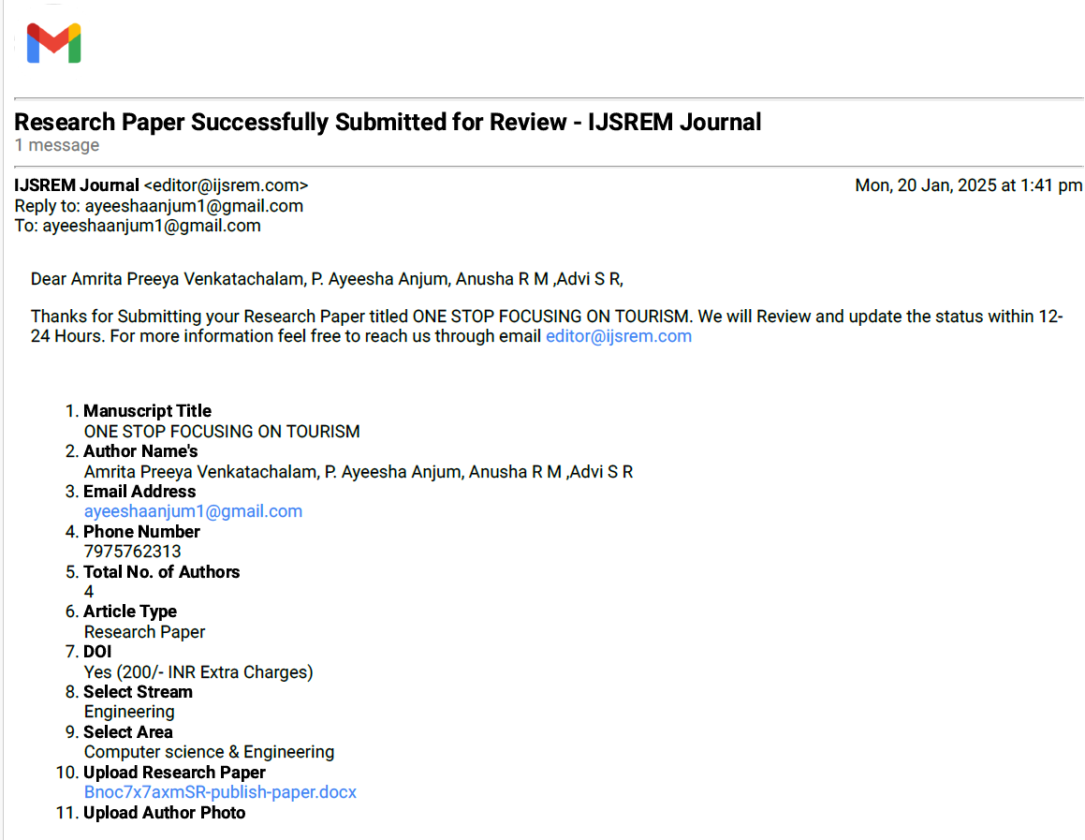
Publication Details

Slide 14
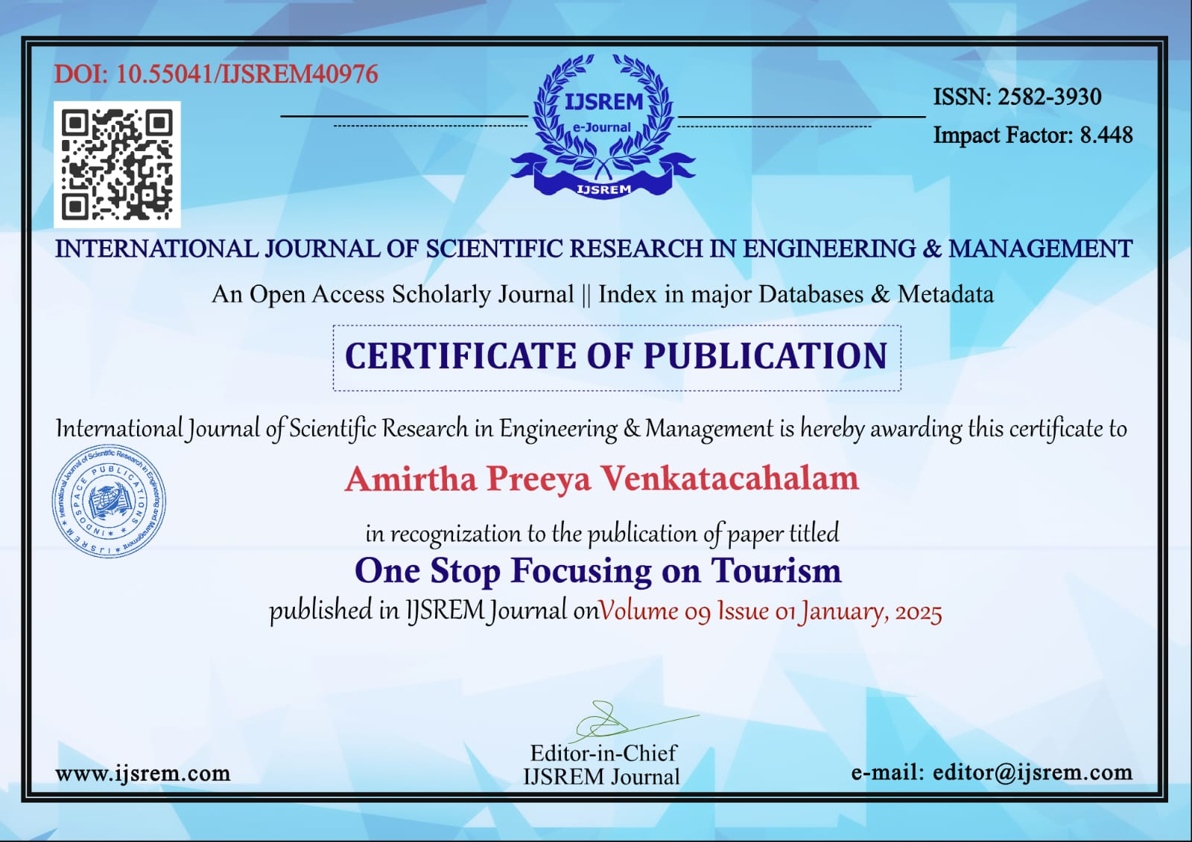
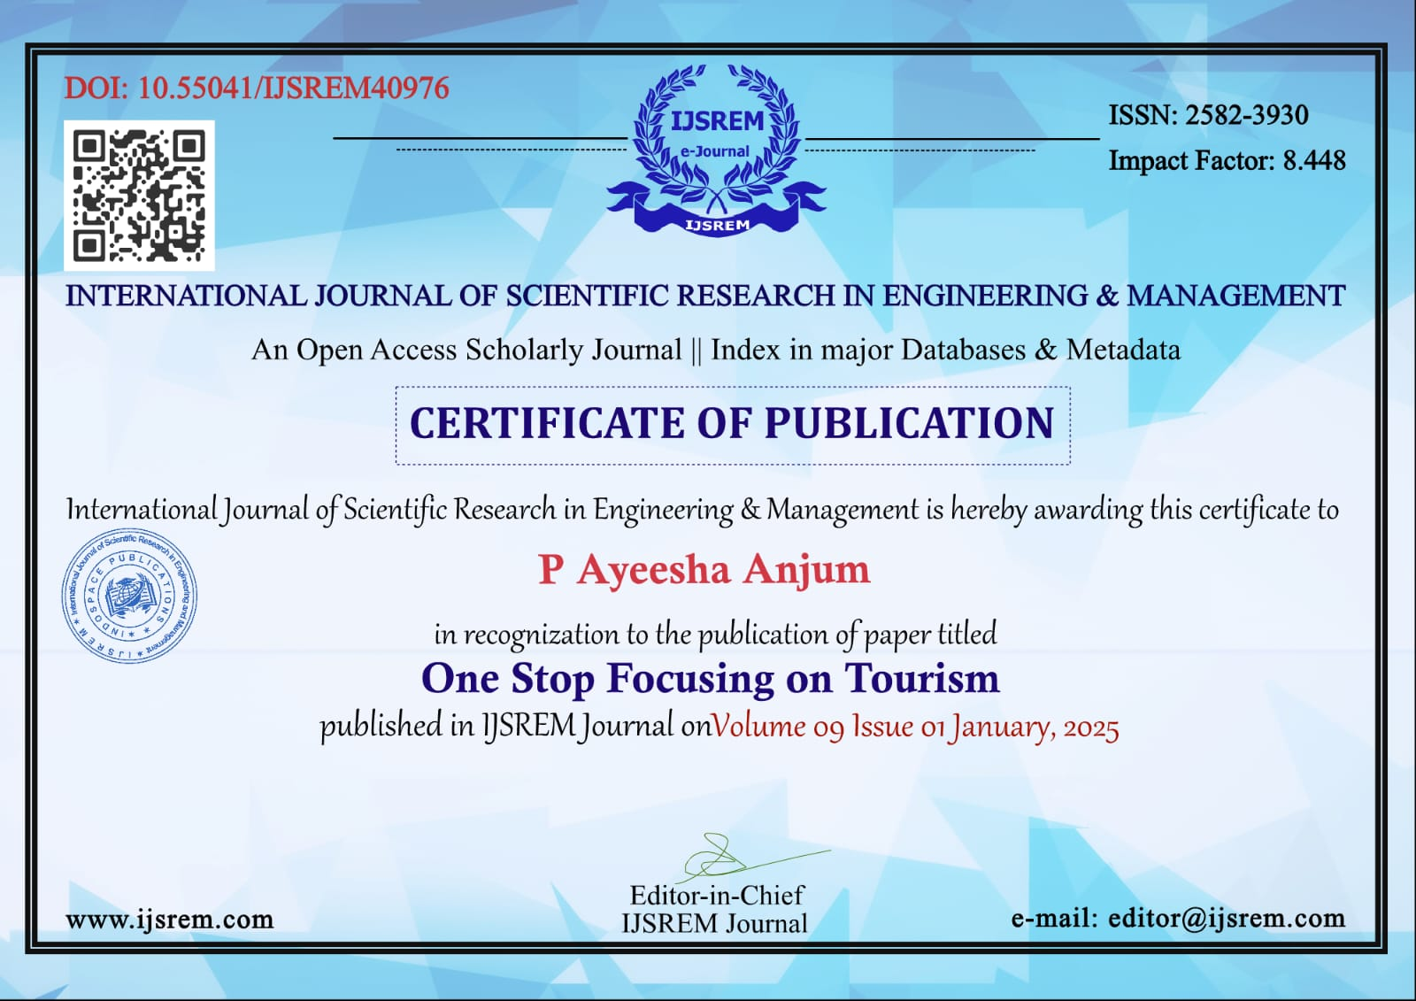
Achievements

Slide 15
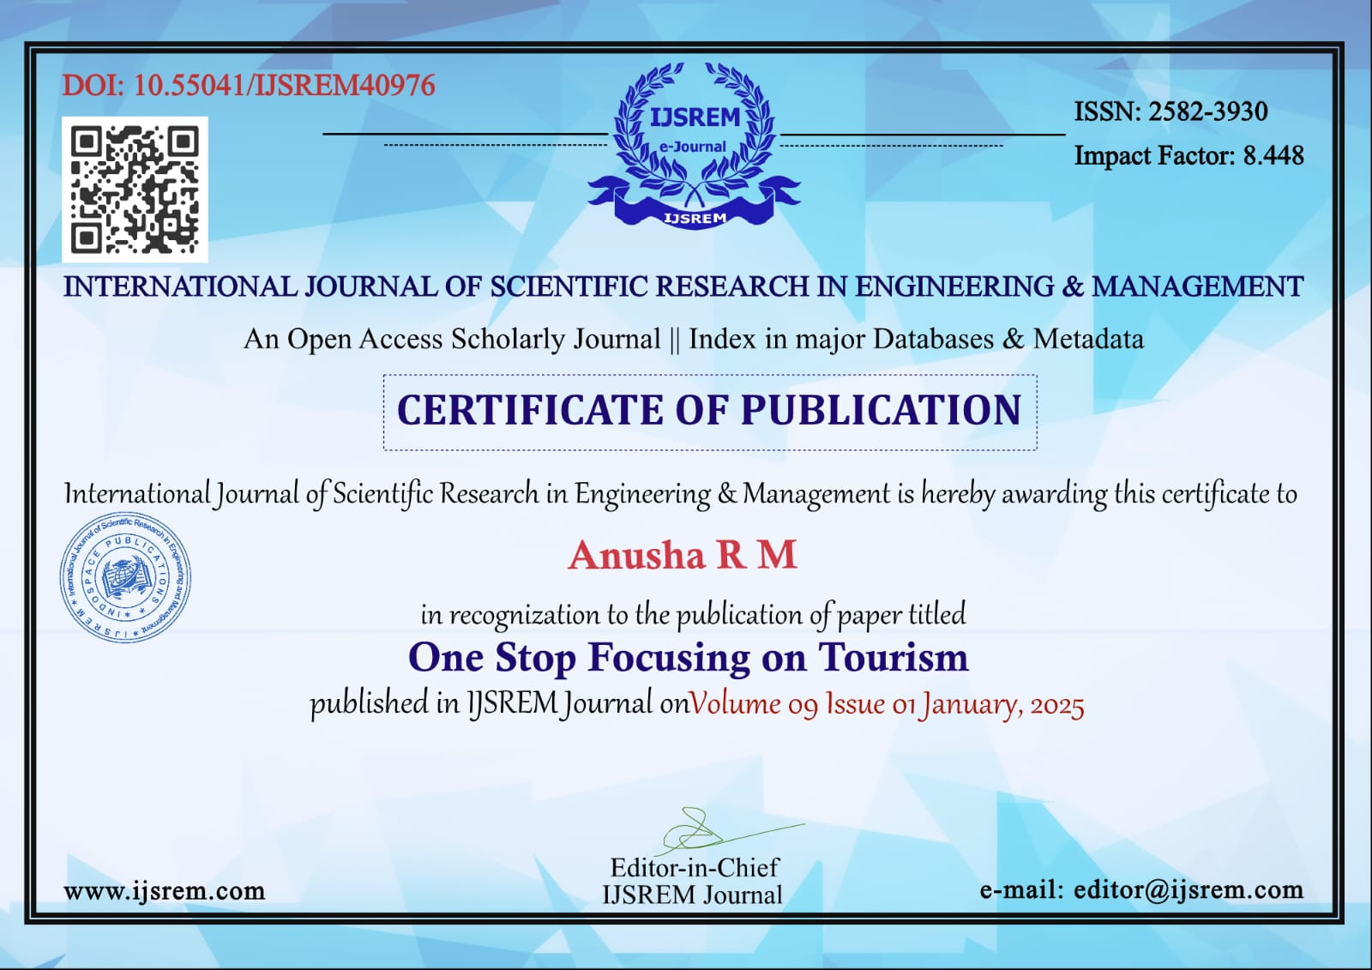
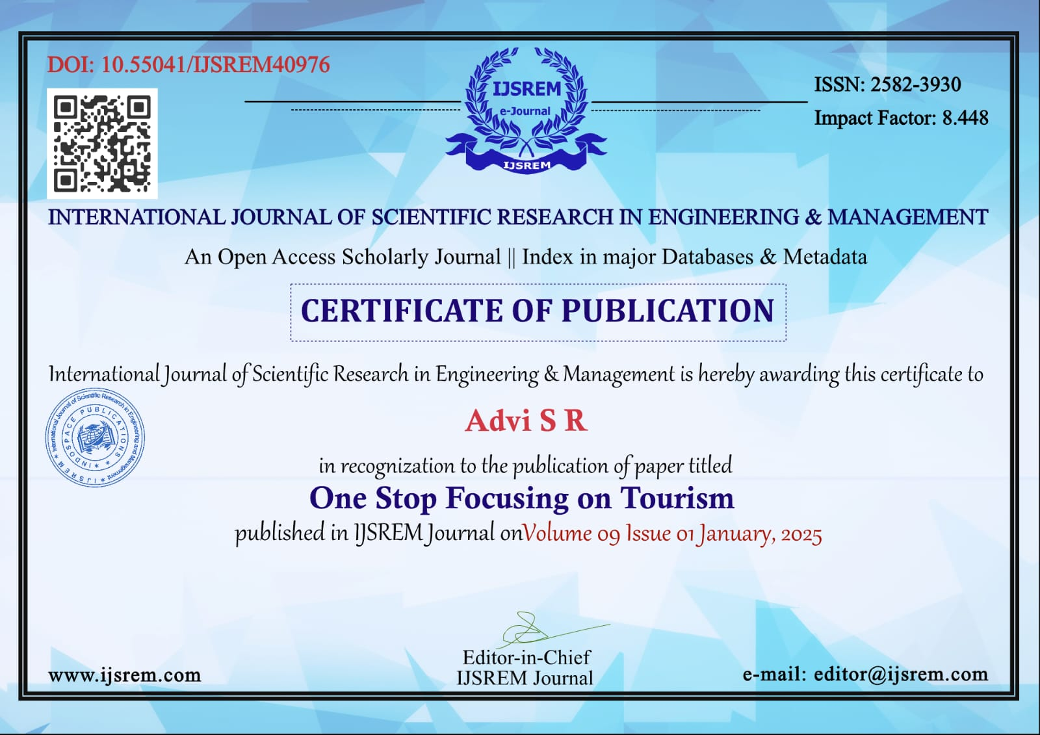

Slide 16
Thank You

